Slide 1

Car Rental Service
Wei Wang
Donghyeok Seo

Slide 2
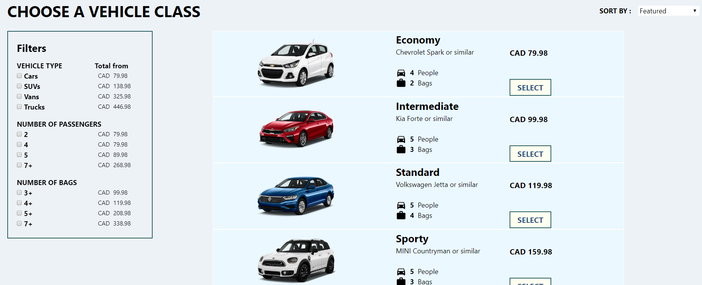
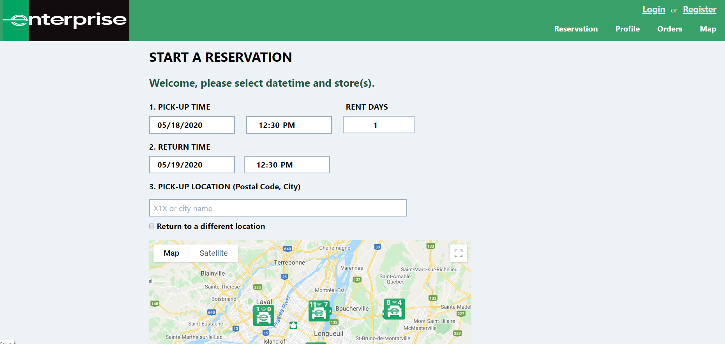
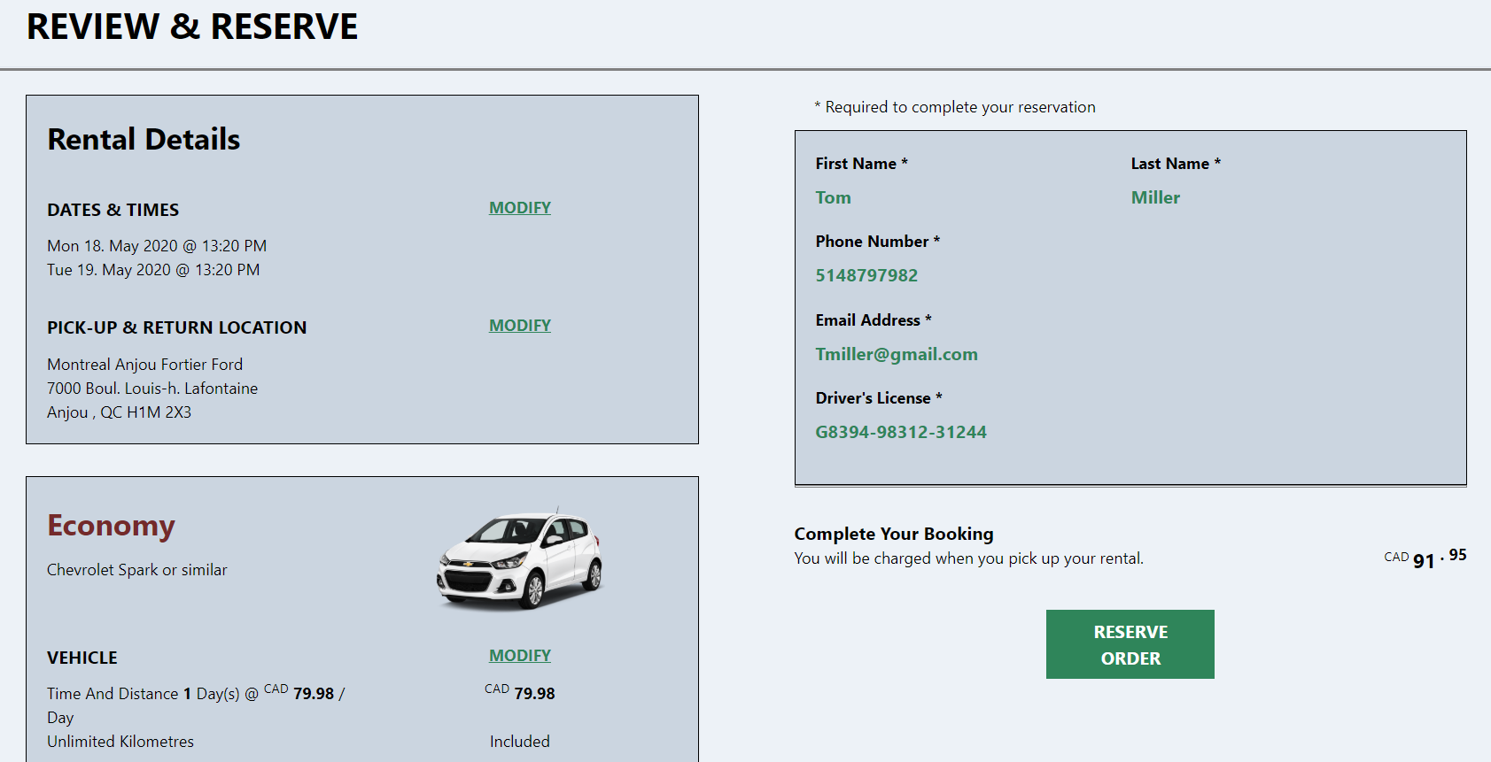
Screenshots (user)
2. Car Selection
1. Index/Reservation
3. Review &Reserve

Slide 3
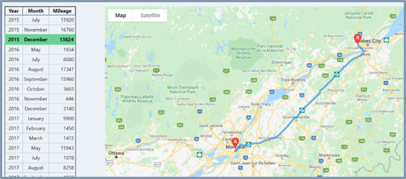
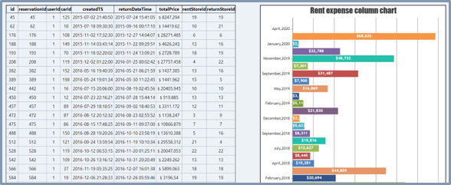
Screenshots (user)
4. Map (User History)
5. Orders (User History)

Slide 4
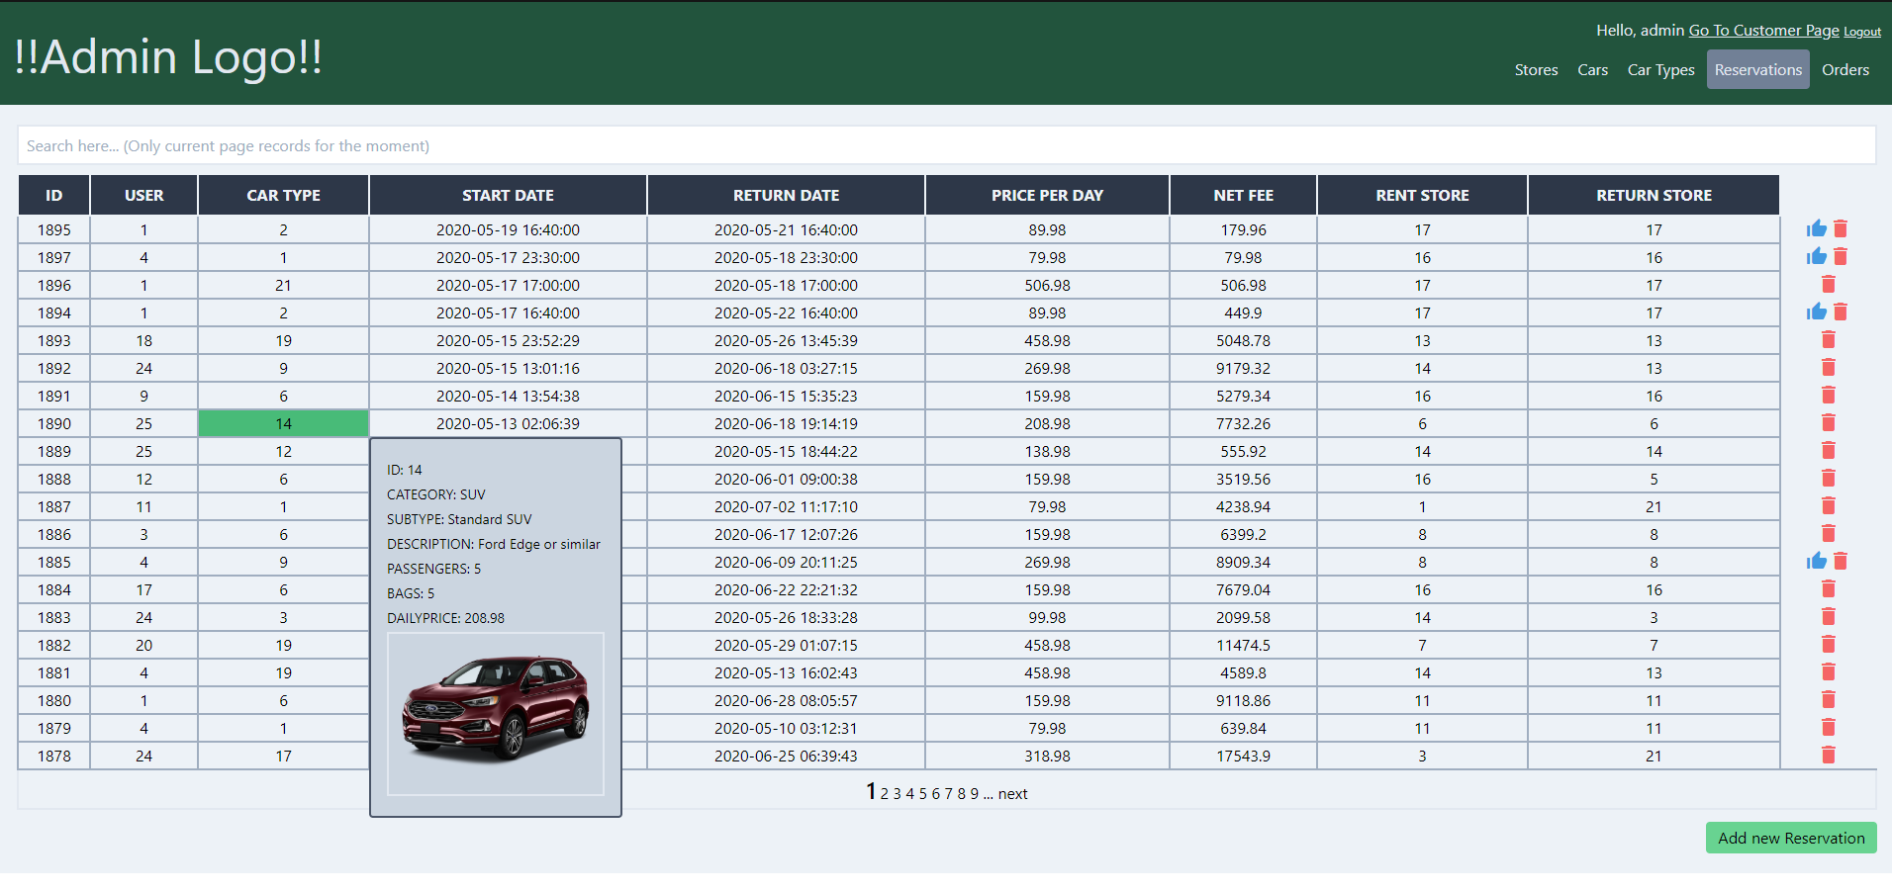
Screenshots (admin)
- Store, Car, CarType, Reservation, Order List

Slide 5
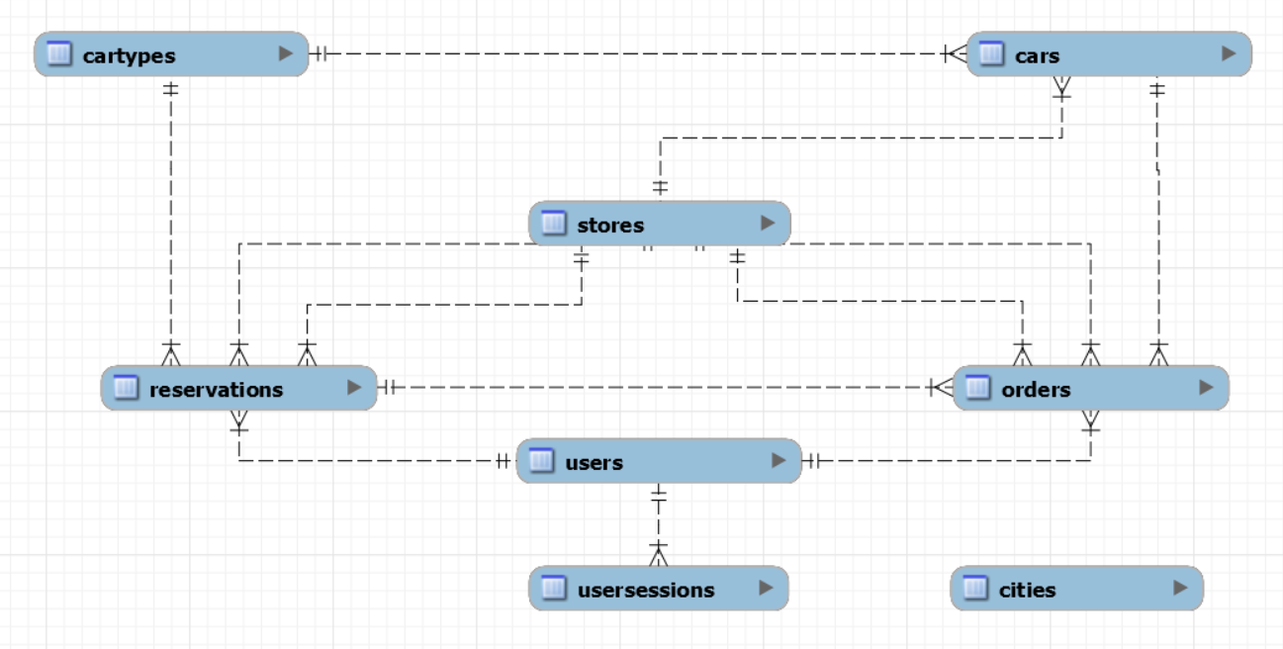
Database Structure

Slide 6
Project Structure
Resources
Tests
Src
Images
Resources
Logos
Css files
Middlewares
Src
Controllers
Templates
Tests
Tests
MockData
Config
Settings
Routes
Config
/

Slide 7
Project Structure
Middleware
Routes
Controller
Request
Response
Responses

Slide 8
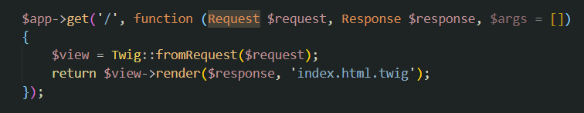
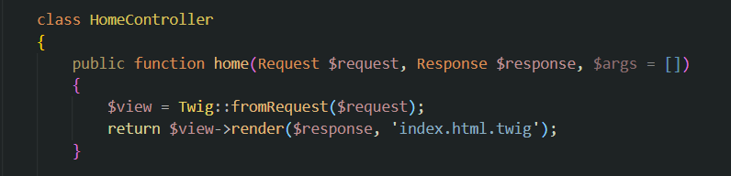
Project Structure (Controller)
> In Route
> In Route
> In Controller

Slide 9
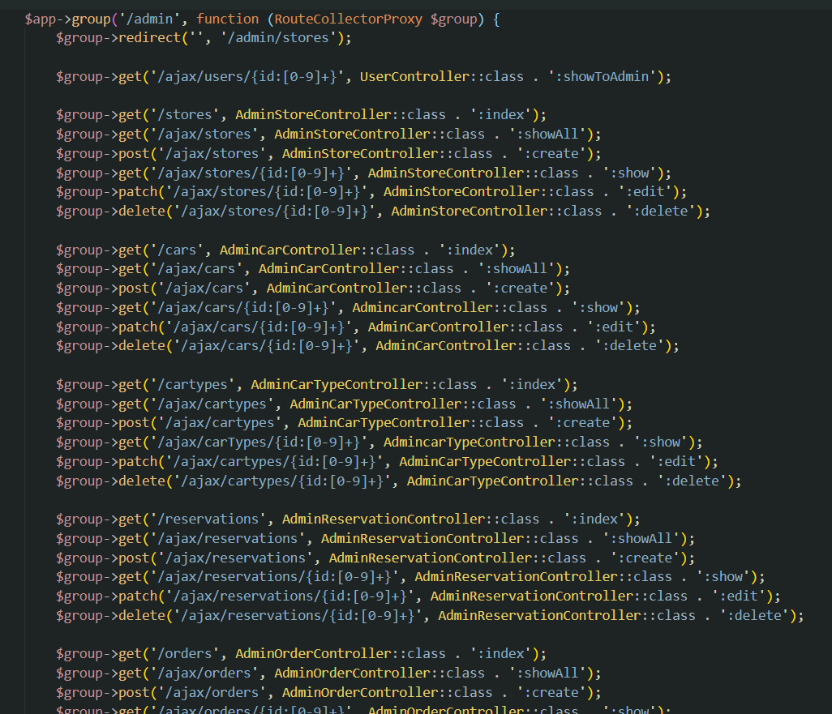
Project Structure (Route)

Slide 10
Project Structure (Middleware)
$app->get('/ajax/stores/{id:[0-9]+}', function ( … )
{
// If user login?
// if user is admin?
…
Return store information
});
$app->delete('/ajax/stores/{id:[0-9]+}', function ( … )
{
// If user login?
// if user is admin?
…
Delete store information
});
Main feature
Main feature
$app->put('/ajax/stores/{id:[0-9]+}', function ( … )
{
// If user login?
// if user is admin?
…
Update store information
});
$app->patch('/ajax/stores/{id:[0-9]+}', function ( … )
{
// If user login?
// if user is admin?
…
Update store information
});
Main feature
Main feature

Slide 11
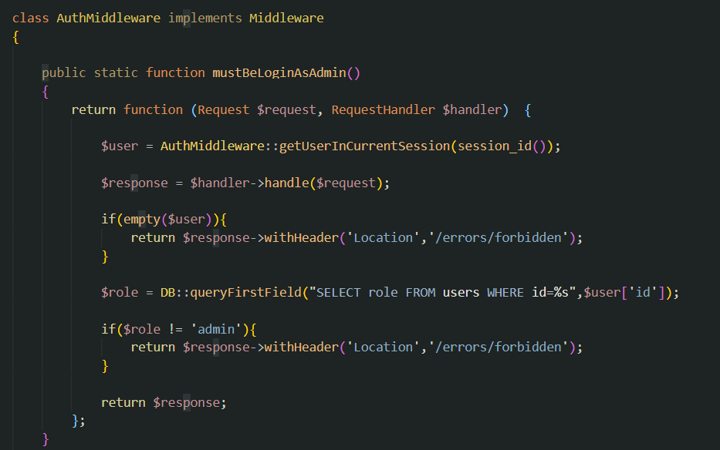
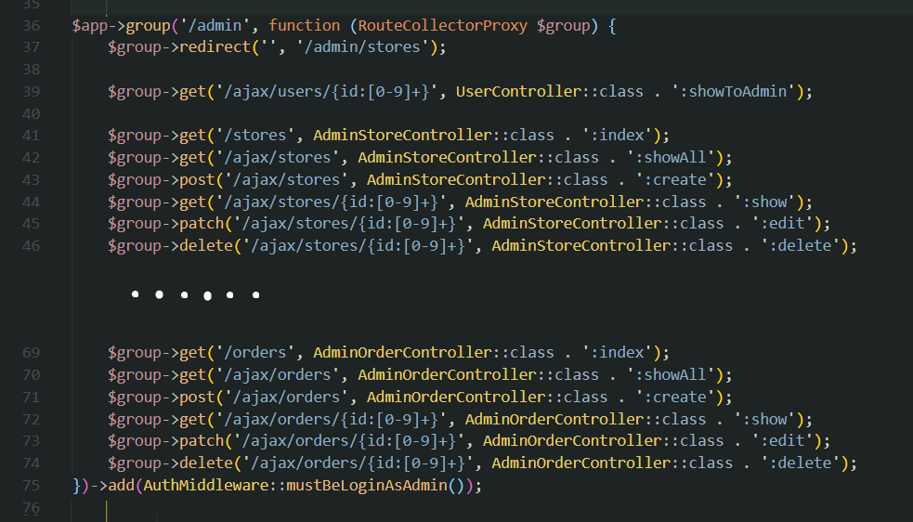
Project Structure (Middleware)
> In AuthMiddleware Class
> In Route

Slide 12
Project Structure
Middleware
Routes
Controller
Request
Response
Responses

Slide 13
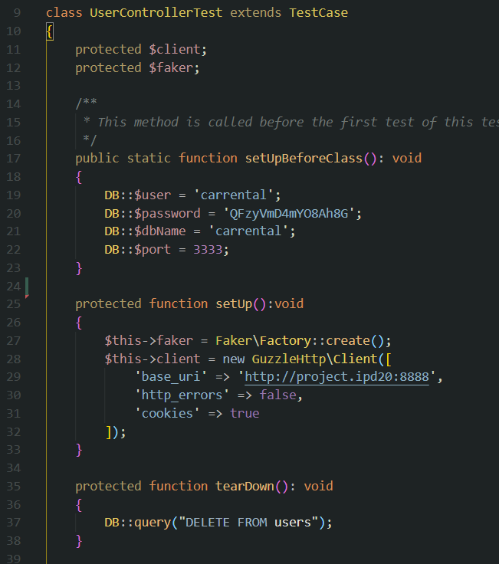
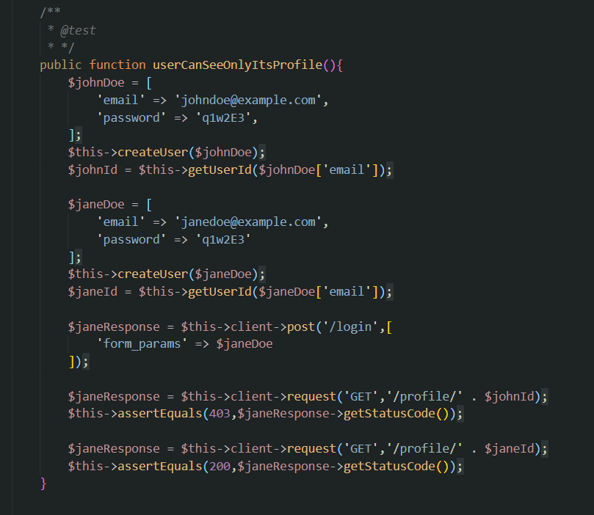
Unit Test ( PHPUnit & GuzzleHttp )

Slide 14
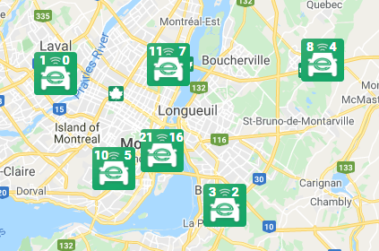
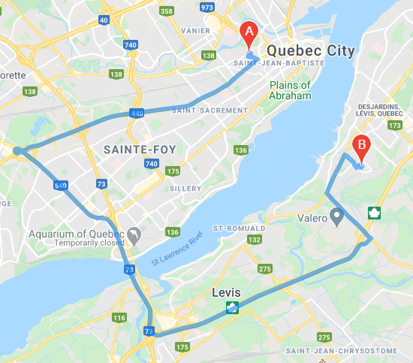
Map requirements
Display stores on google map.
Use company logo as markers.
Show details of a selected store.
Retrieve and update available car number on the markers.
Draw routes of finished orders on google map.
(apply locations of different stores).

Slide 15
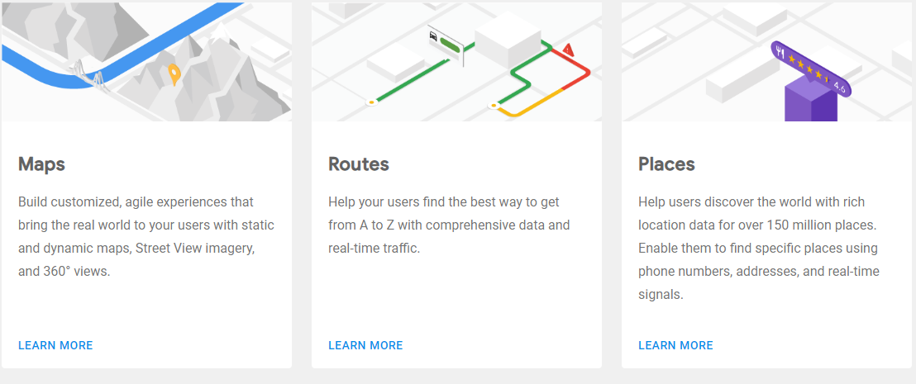
Google Map API

Slide 16
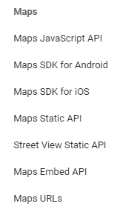
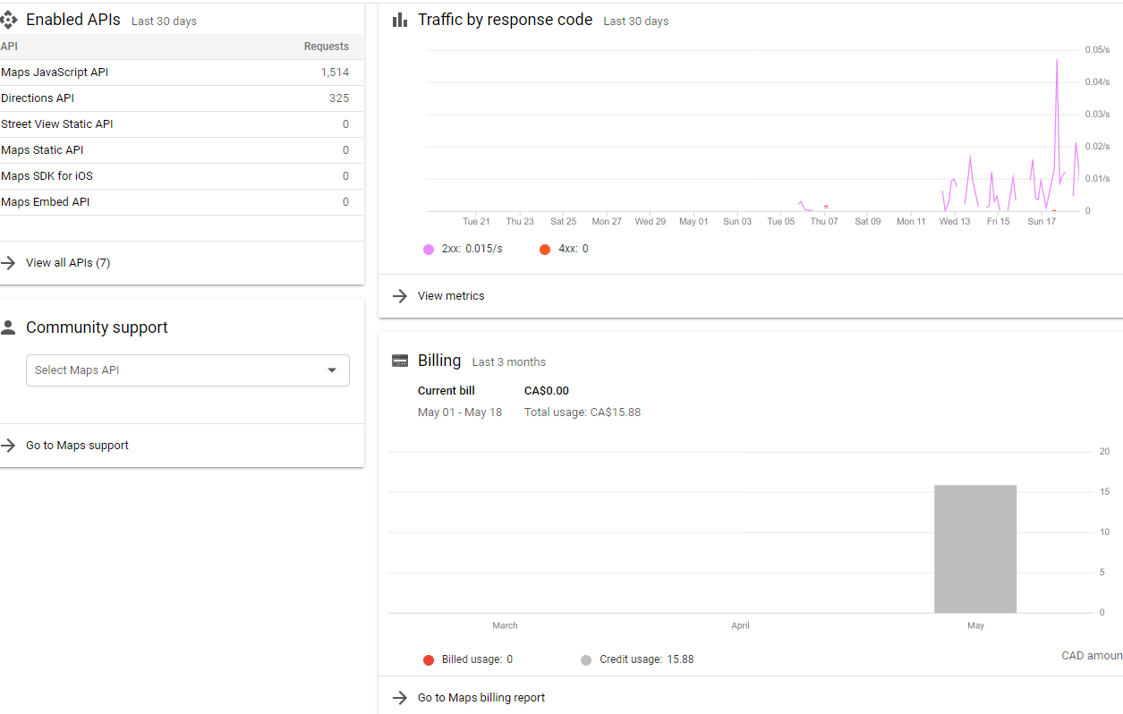
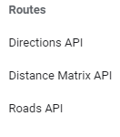
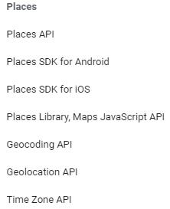
Google Maps

Slide 17
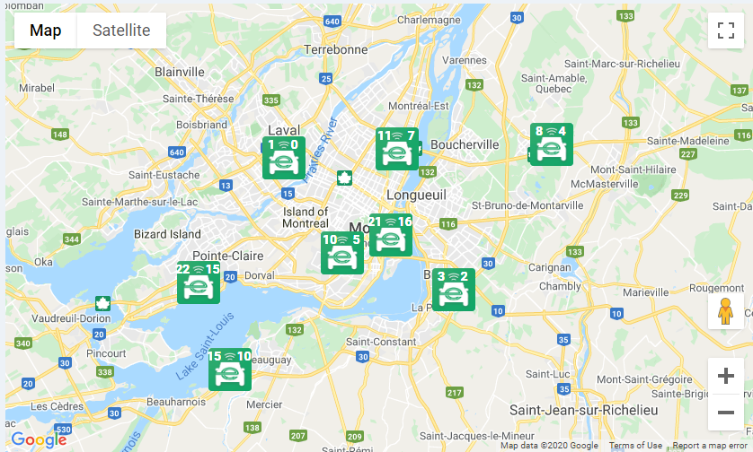
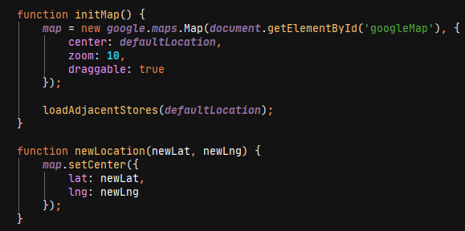
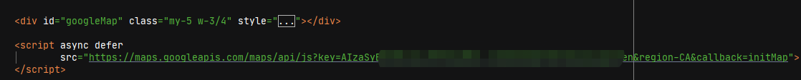
Google Maps – Maps API

Slide 18
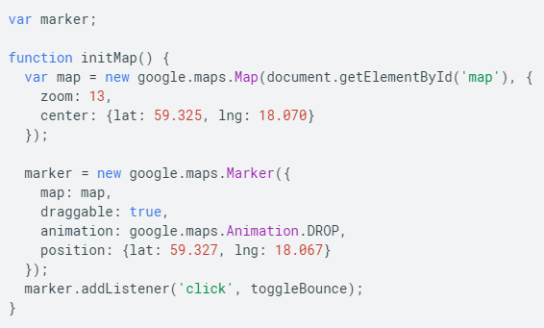
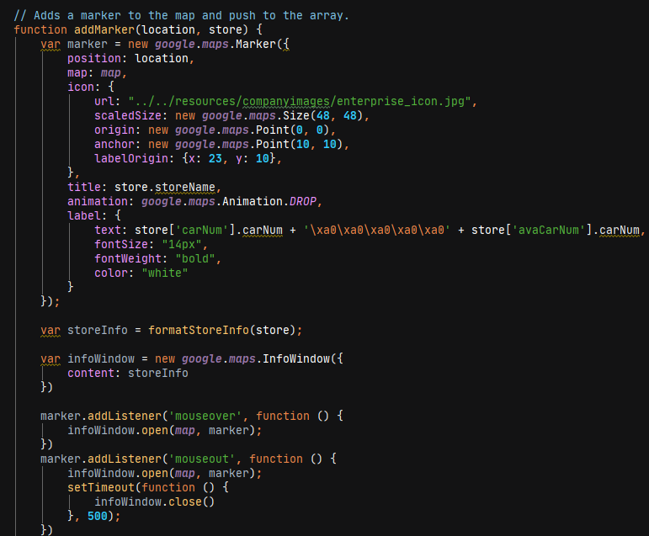
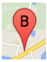
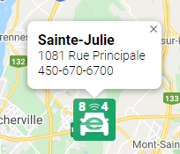
Google Maps – Maps API

Slide 19
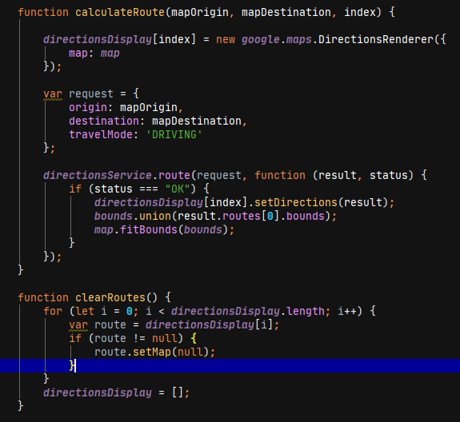
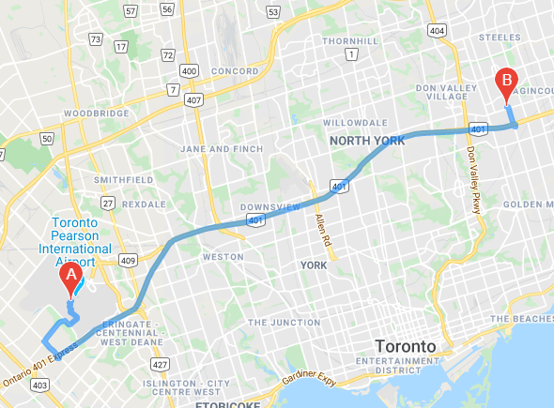
Google Maps – Directions API

Slide 20
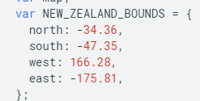
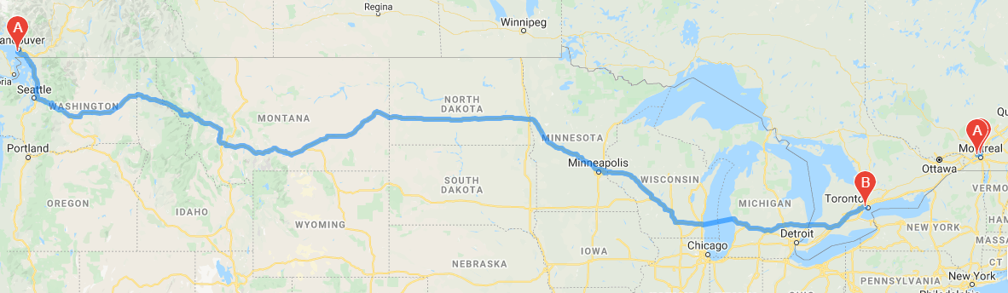
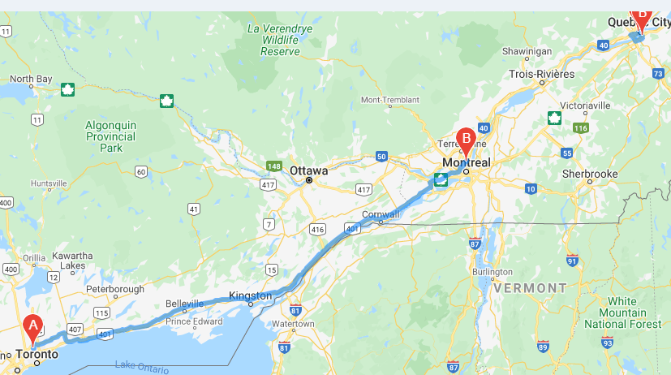
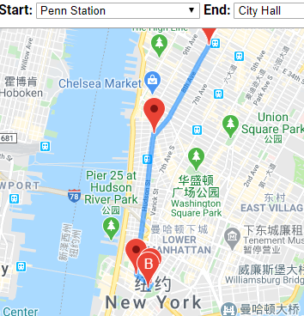
Google Maps – Directions API

Slide 21
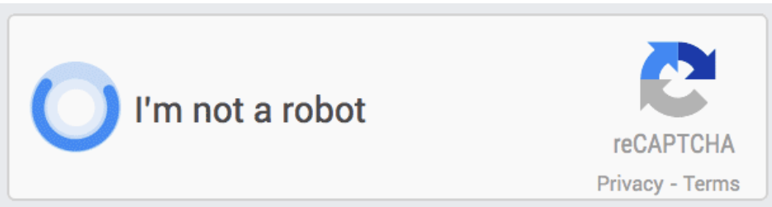
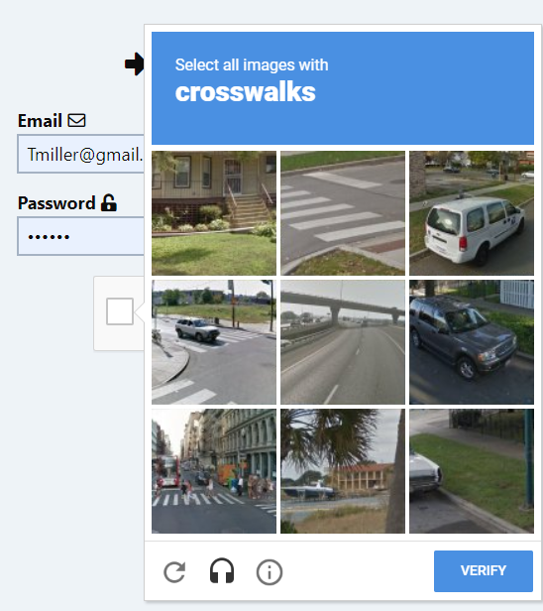
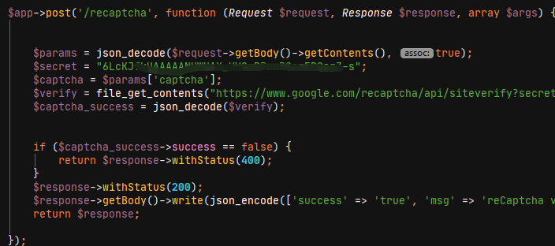
ReCaptcha - V2

Slide 22
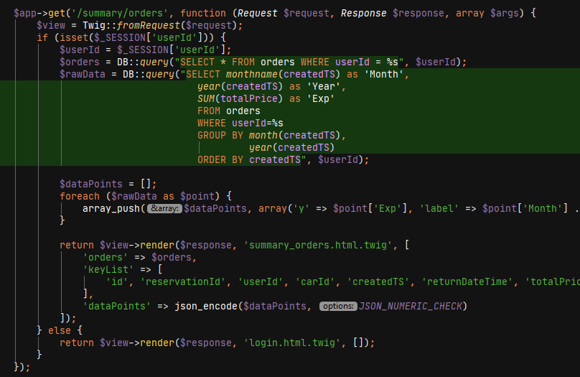
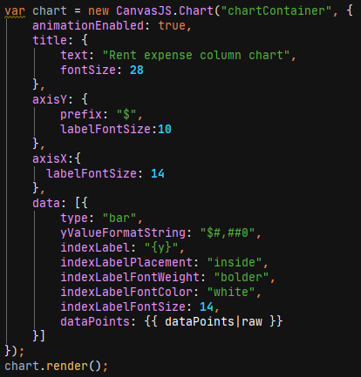
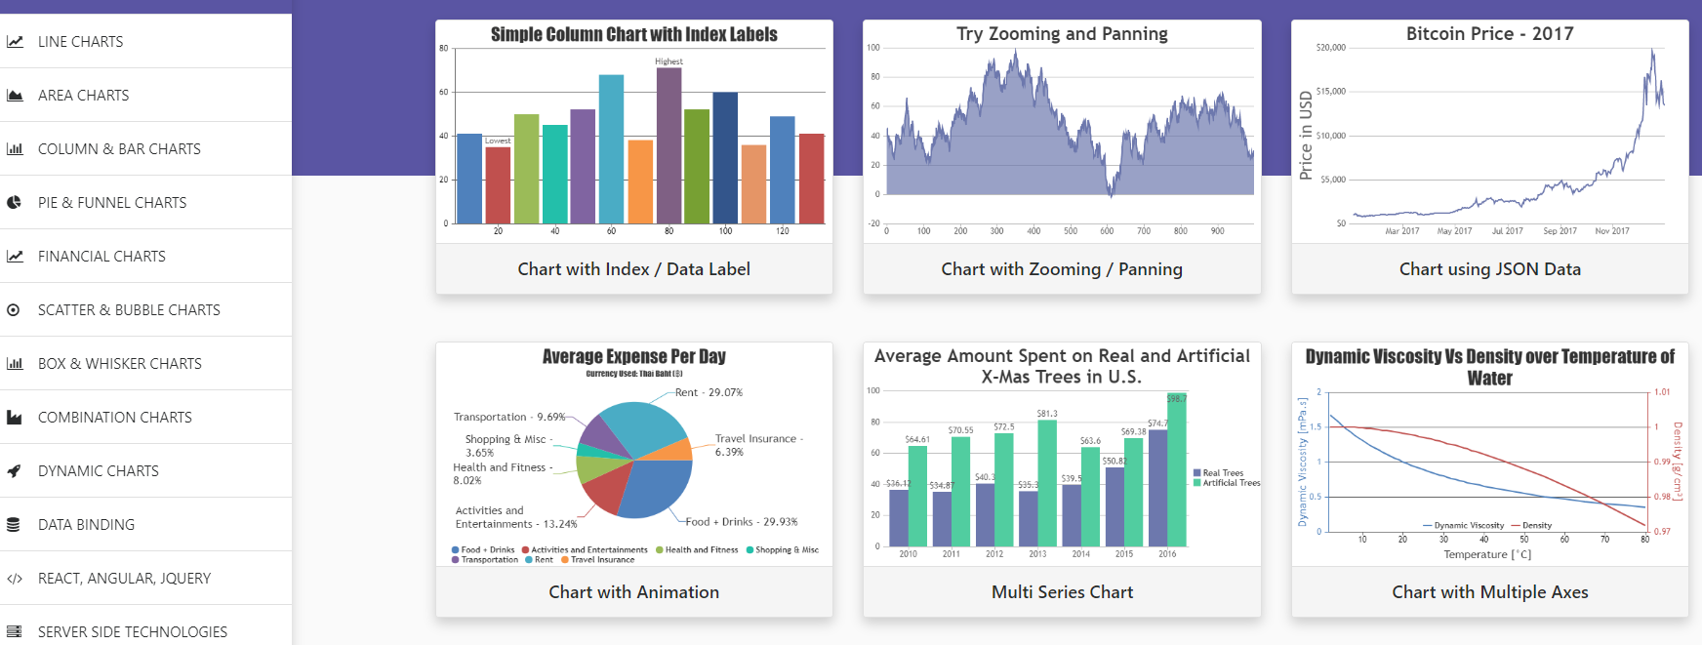
CanvasJS

Slide 23
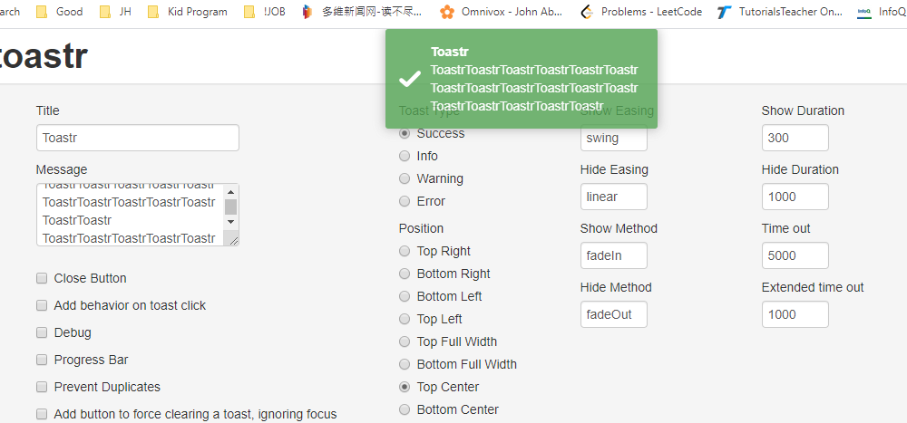
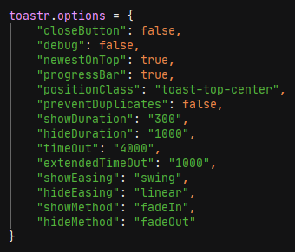
Toastr

Slide 24
Todo
Improve user authentication
Improve order/reservation validation etc.
Add more user functions: password reset etc.
Admin page validation, search

Slide 25
Thank you!

